Slide 1

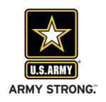

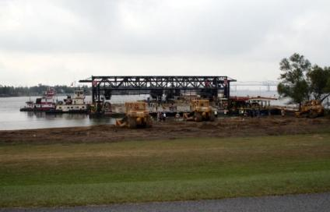


Exploring Redesign and Replacement of the
Mat Sinking Unit
John W. Cross
Commander,
Vicksburg District
March 2015
US Army Corps of Engineers
BUILDING STRONG®
Notes:
1
Good morning. I would like to share with you our developing plans and concepts for possible replacement of the Mat Sinking Unit.

Slide 2
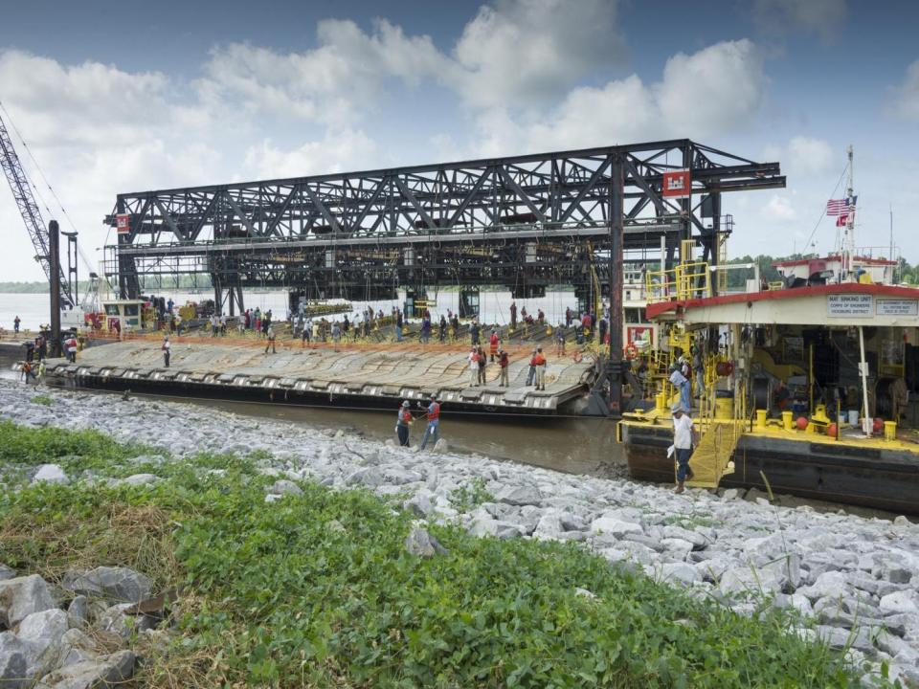
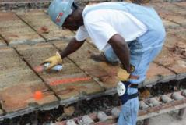
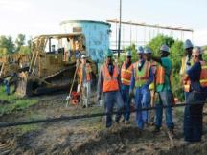
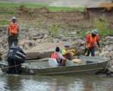
Mat Sinking Unit is Reaching the End of Its Effective Life
Built in 1948
Cost of mandatory repairs @ $5-6M annually
Numerous safety issues
Spending money yearly in attempt to improve safety
No automation requires large amount of manual labor
No warning sensors to indicate dangerous conditions nearby
Webs of cabling required to operate

Slide 3
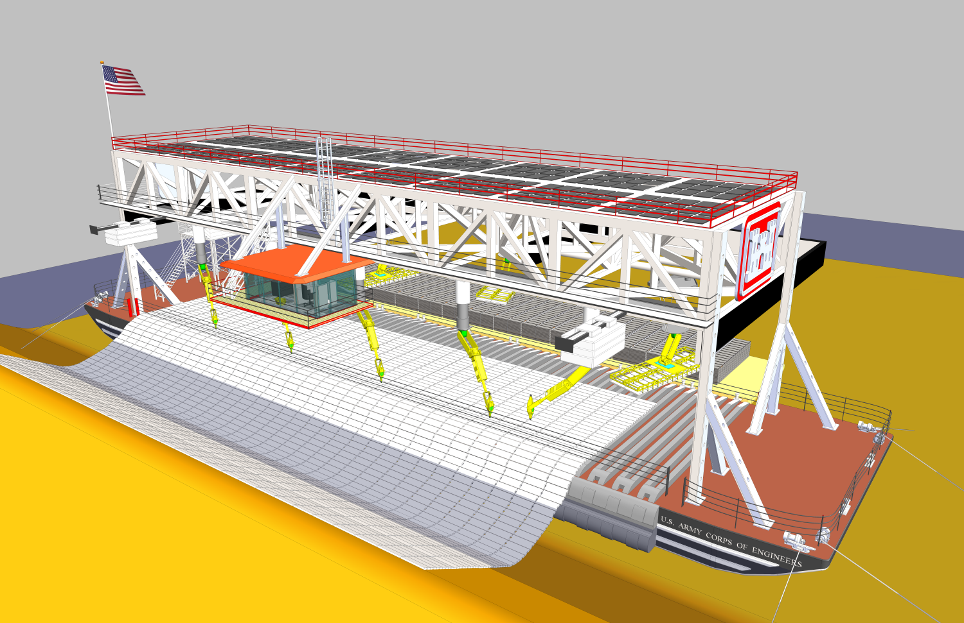
A New Revetment Machine Will…
Be more efficient and cost effective than current process
Reduce the size of required associated plant
Add higher paying technical jobs
Reduce fuel consumption (carbon footprint)
Reduce annual repair costs
Have more automations and safer working environment
Be more compact and mobile offering less channel restriction
Allow armoring of the channel for the next 50 years

Slide 4



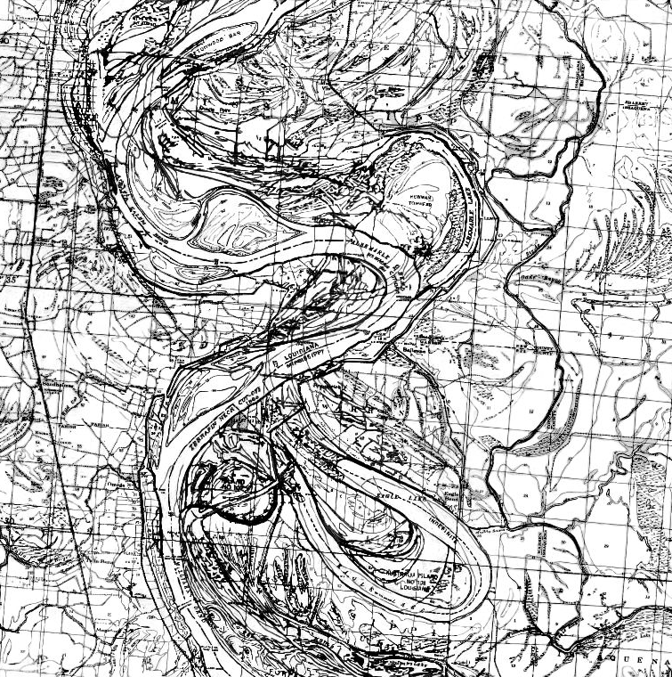

Controlling
the
Mighty
Mississippi River
Without armoring, the River is a constantly attacking force capable of:
Cutting a new channel
Breaching a levee system
Destroying property and threatening populations
Interrupting navigation and commerce
Disrupting agricultural production
Endangering natural habitats
1765
1820 - 1830
1881 - 1893
1930 - present

Slide 5
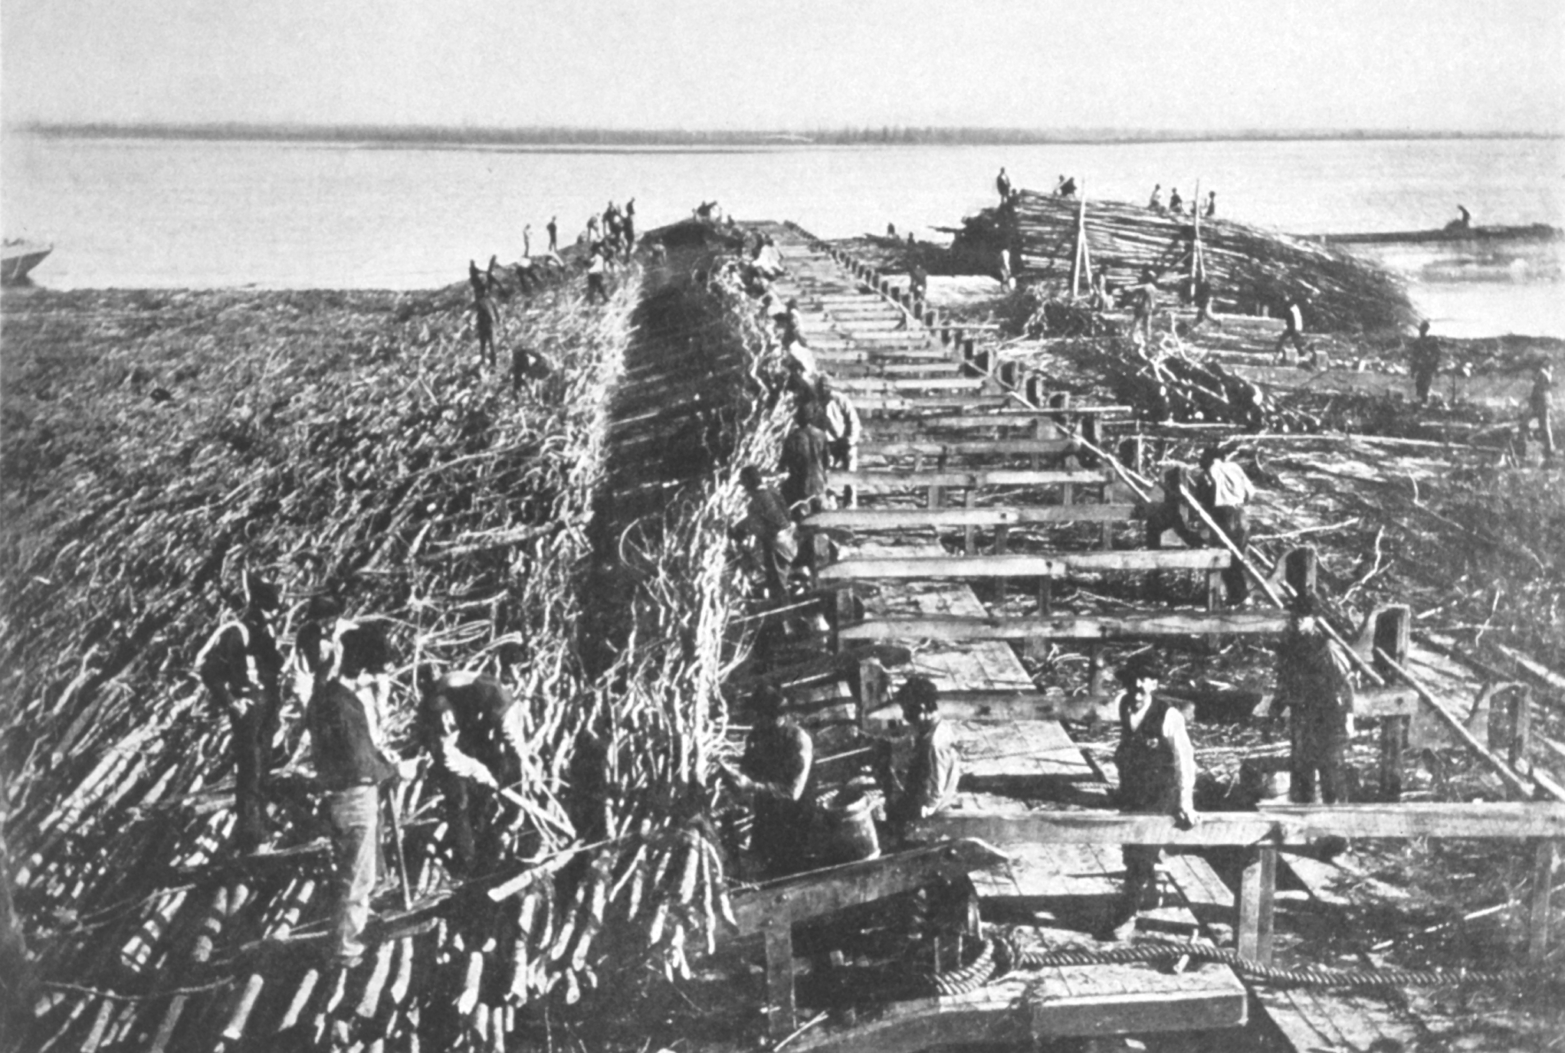
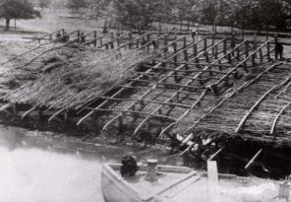
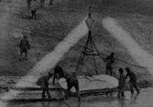
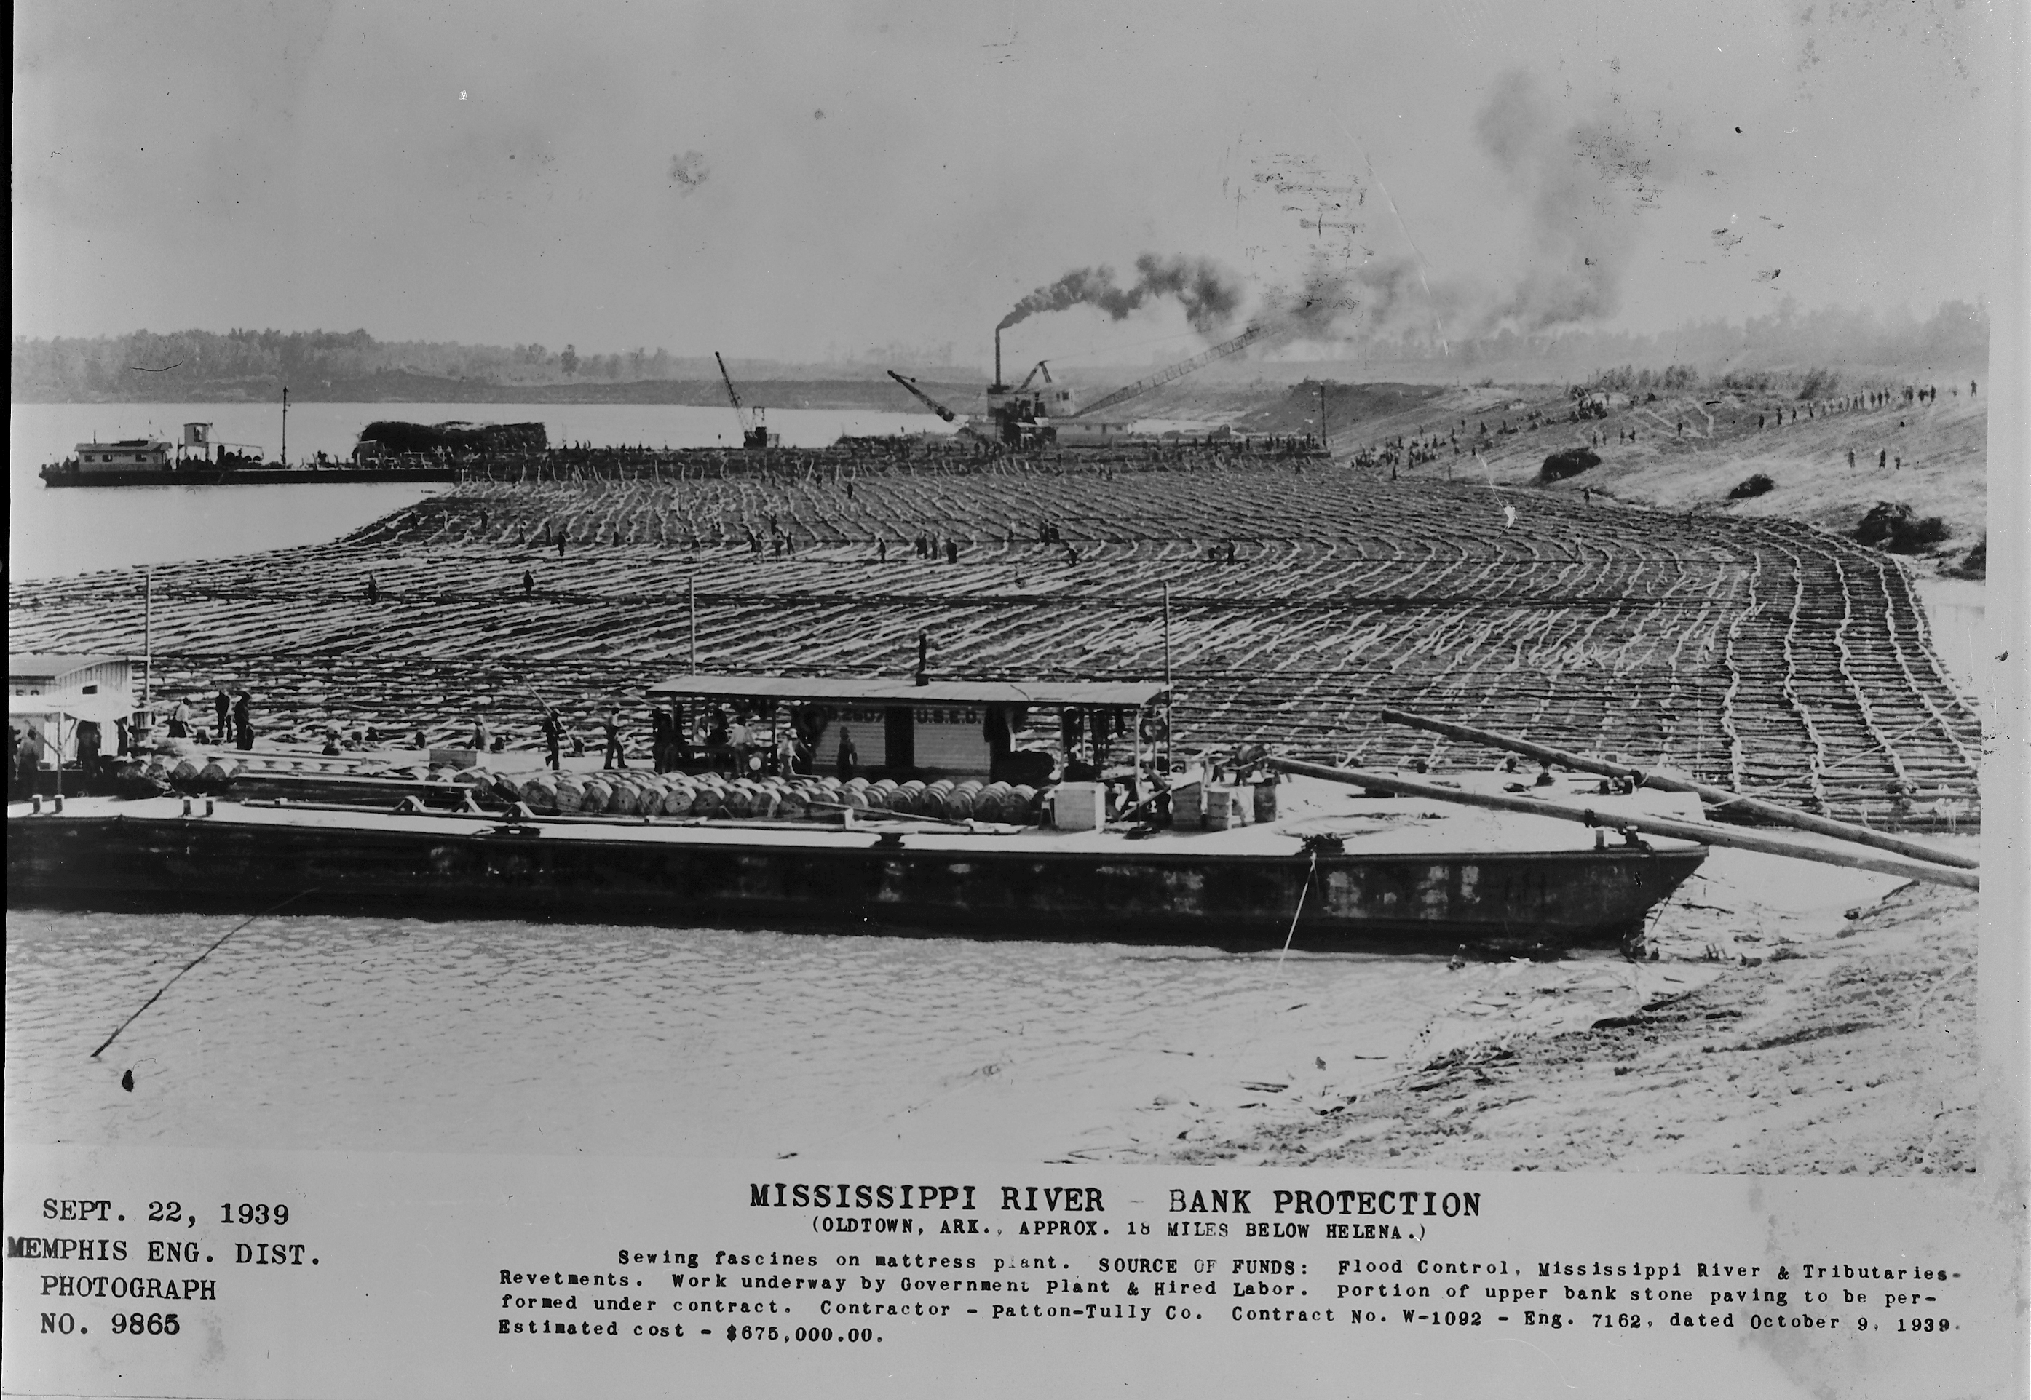
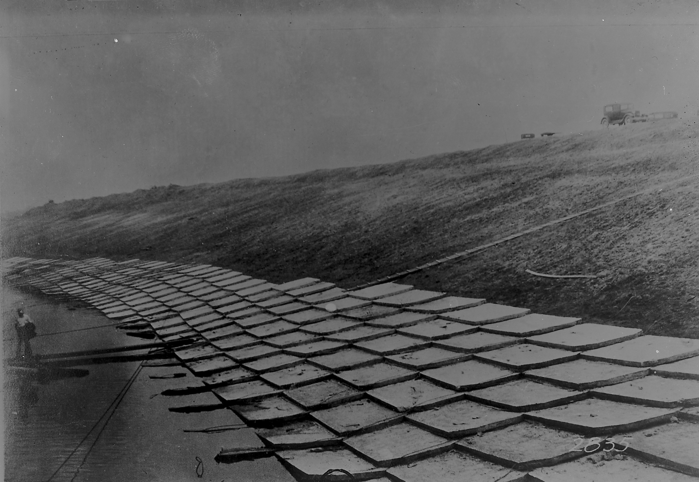
Earlier Methods of Stabilizing the Channel
“Weaved” Willow Mat
Placed
Concrete
Slabs
1939 – Wood and Stone Mat
Notes:
Early mats were constructed of willow fascine or lumber framework mattresses that were wired together to form protective structures that were then placed on a graded slope. Mattresses were backfilled with silt and armored with rock. ACM was apparently invented and patented in 1914/1916. MVK sank the first ACM in 1917. It's configuration and placement methods were continually modified until the 1940's. The organized high productive method that is used today was "put together" right after WWII. The mat boat Vicksburg had until the '90's was actually constructed in 1926. After the consolidation, Vicksburg received Memphis District's mat boat, #4801. It's keel was laid in 1948.

Slide 6
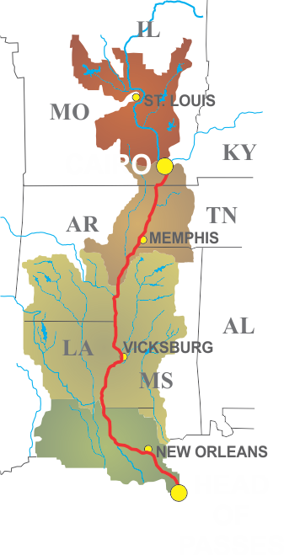
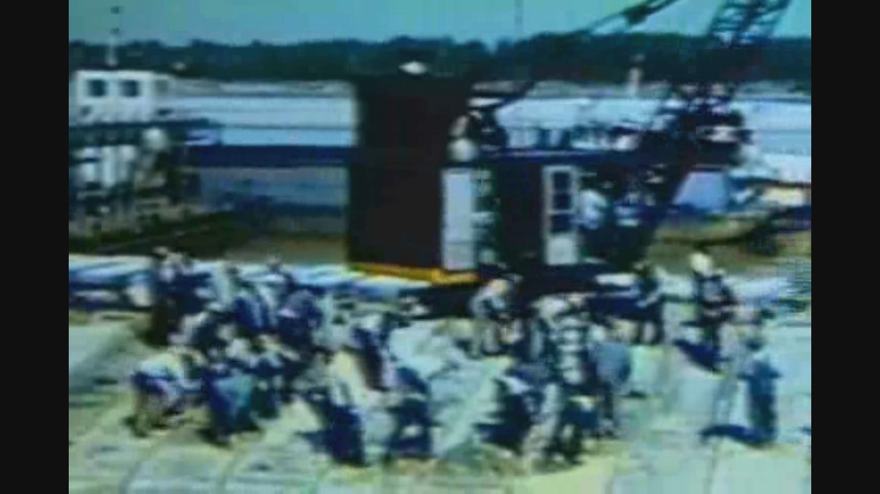
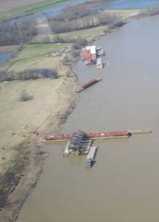
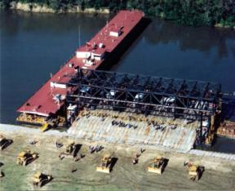
The Present Method….
Notes:
The current method of delivery of revetment (ACM) is the Mat Sinking Unit (MSU). The MSU was built in 1946 and was considered at that time, state of the art. However, the MSU is fast approaching an unreliable status with no existing plans and specifications for a replacement. The cost of making necessary maintenance, repairs, and meeting safety codes is approaching $3 million to $5 million annually. Most of the equipment has outlived its life or is considered obsolete. Some of the devices are so antiquated, that supplies are sole sourced and very expensive. For example, the pulley system and gantry cranes, as well as the diesel engines are one of a kind items which require extensive fabrication in case of unplanned maintenance or breakdown. The wire used in the below deck pulley system is a product of Italy, requires months of lead time, and is very costly. Tying tools are custom made, require constant maintenance, and employ 8 full time employees for repair only. Because the current method requires extensive manual labor, the MSU employs approximately 325 personnel to fully man the vessels and lay the ACM. The MSU has placed over 1000 miles of articulated mattress over the past 7 decades as a construction item. However, almost 70 years later, this mission has evolved into a maintenance project and the need for maintenance ACM will continue indefinitely.

Slide 7
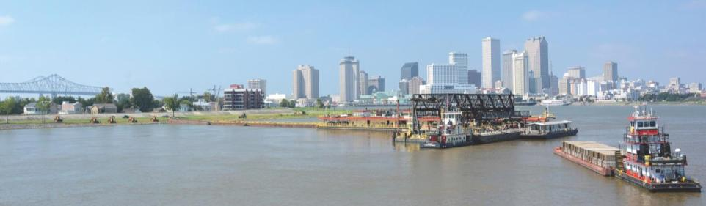
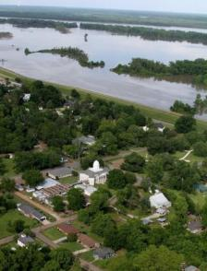
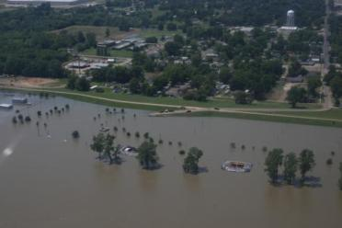
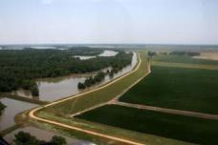
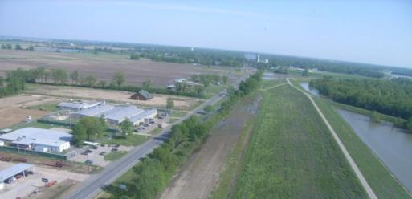
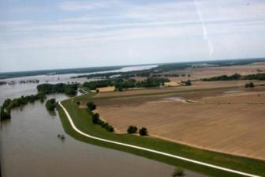
ARMORING THE RIVER
to Protect Commerce
and Prevent Flooding
Notes:
A stable channel is more efficient in moving high river stages while also reducing bank caving. As a result, levees, which are critical to the protection of a city such as New Orleans are far less likely to be compromised when they are most needed.

Slide 8
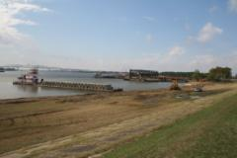

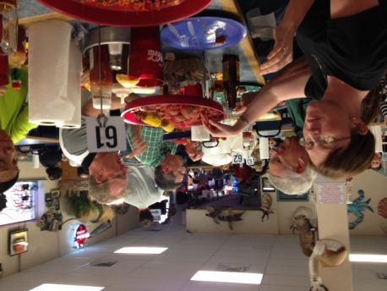
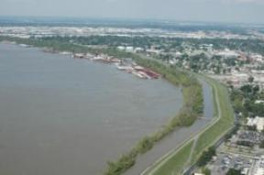

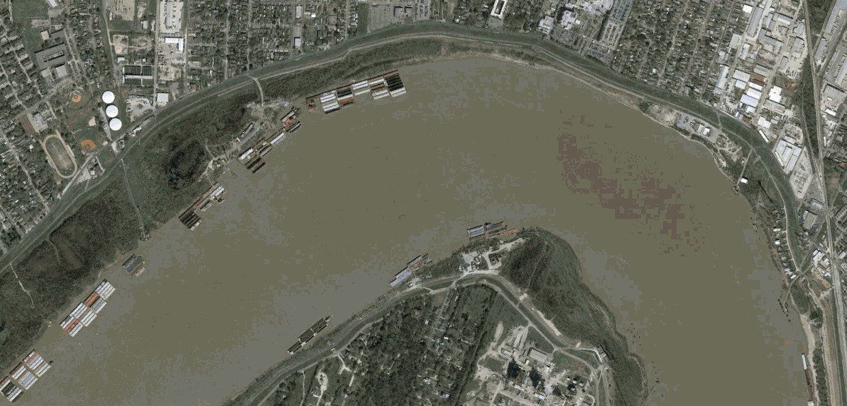
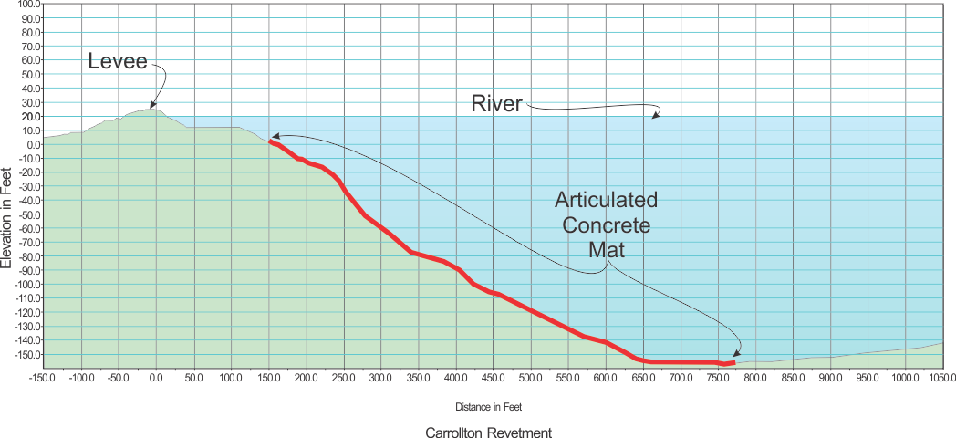
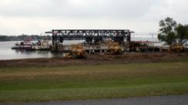
Protecting New Orleans
Carrollton Revetment
Notes:
Of course there are still challenges to keep the channel from migrating and threatening nearby levees. In the photos on this slide, which is in the Carrollton Bend Reach at New Orleans you see the close proximity of the levee to the Mississippi River channel. The area around New Orleans is especially problematic as the river channel is deep and river banks are steep as illustrated by the cross-section view of the Carrollton Revetment. Mat must be laid beyond the channel thalweg to prevent toe scour and destabilization of the banks. A scour could threaten the stability of the levee.

Slide 9
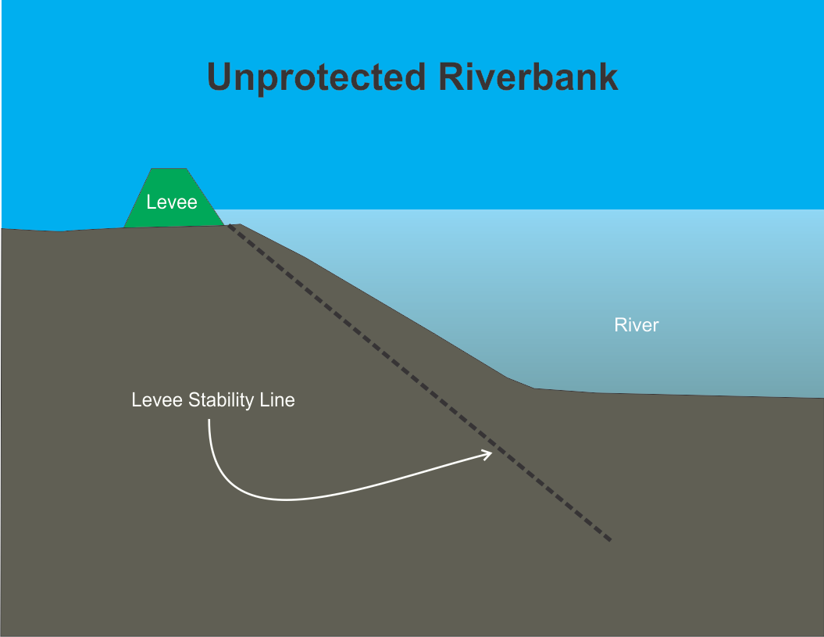
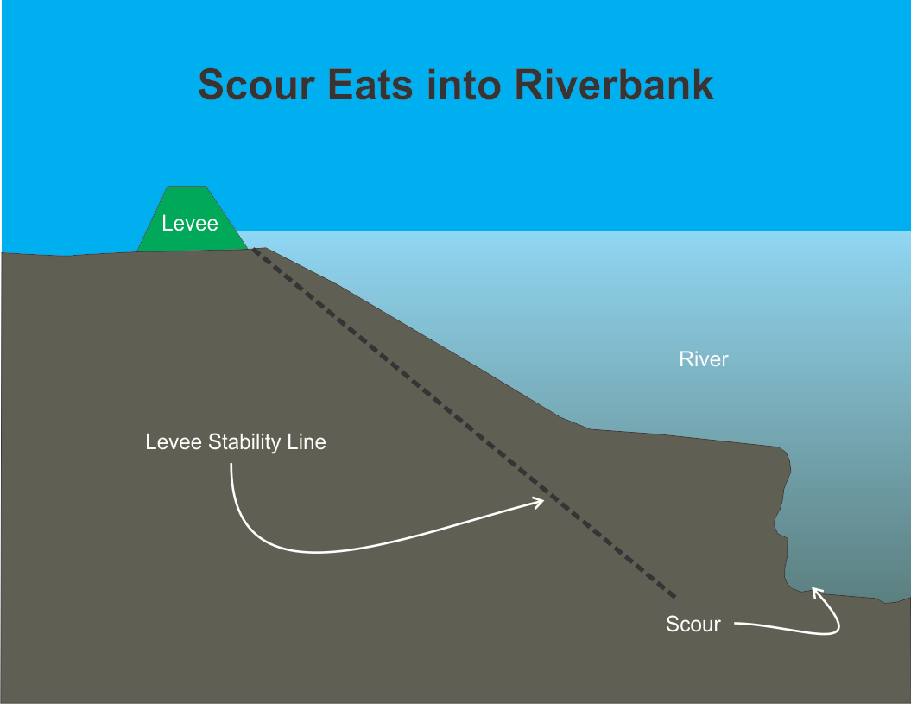
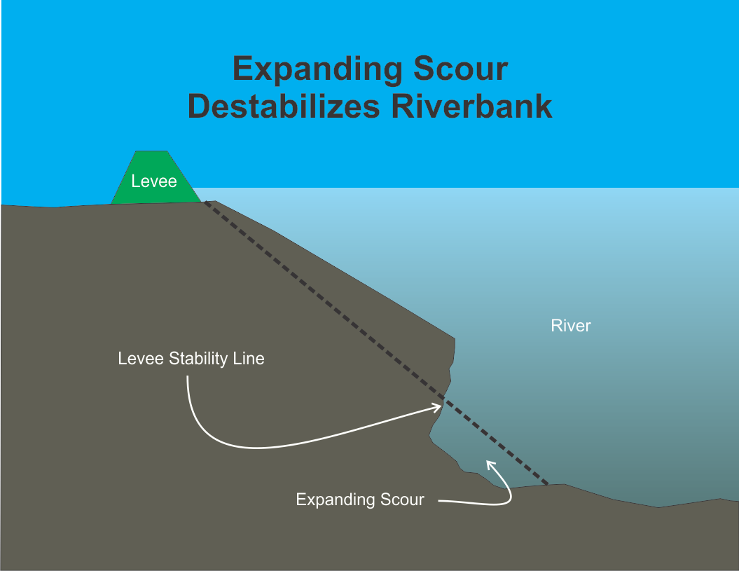
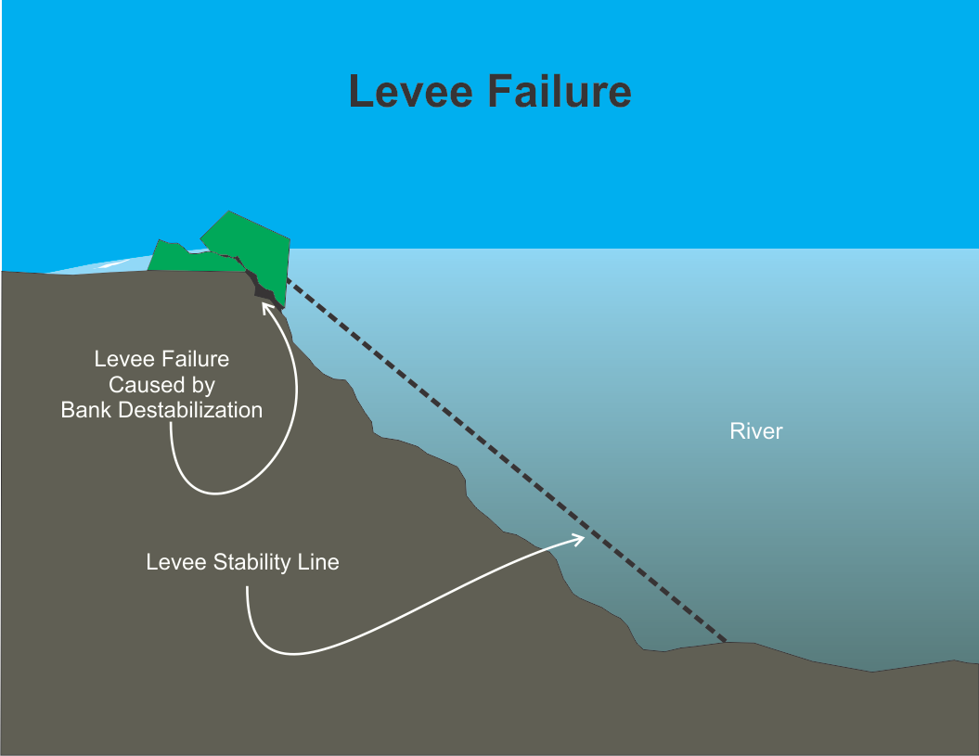
Notes:
In this series of slides, you see how an expanding scour could destabilized an unprotected riverbank resulting in levee failure.

Slide 10
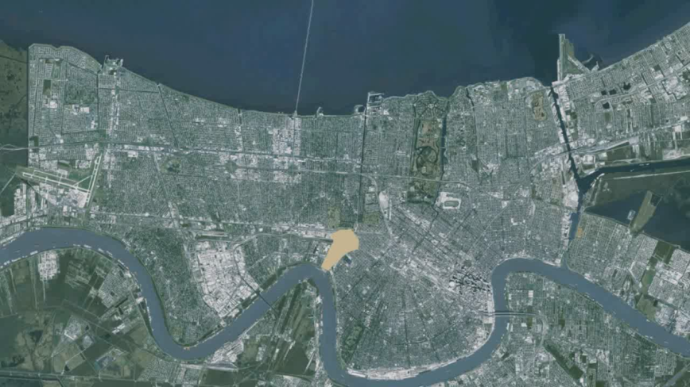
Levee Failure at New Orleans would be Catastrophic
…no time to react to rapidly spreading flood waters
Notes:
In this animation, you see how quickly a levee breach in New Orleans could inundate vast areas of the city in less than an hour. Flooding from directed river flow
creates a tremendous breach enlargement. Many structures will be torn off foundations. Water will carry heavy sediment, sands , clays and silts. There will be no reaction time and people will not have time to climb on top of things to avoid the rising water. There could be thousands of casualties. Much of damaged infrastructure will take substantial amounts of time and money to rebuild.

Slide 11
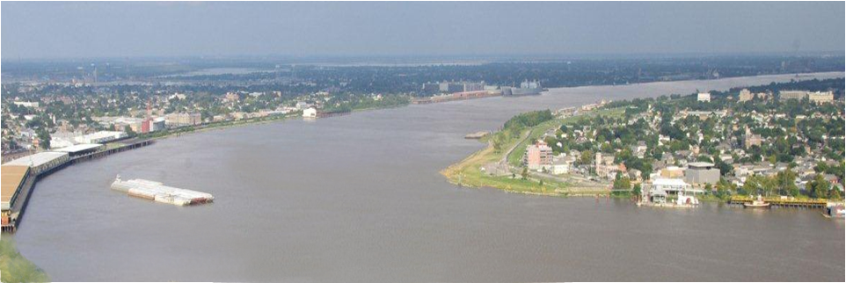
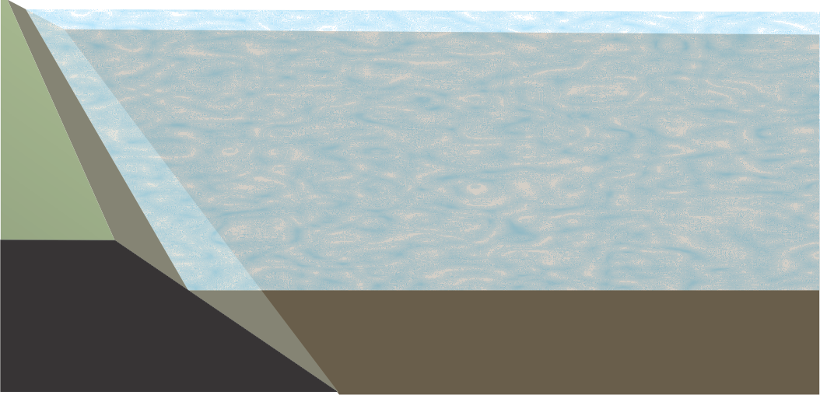
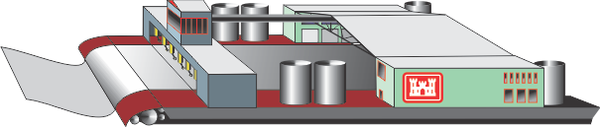
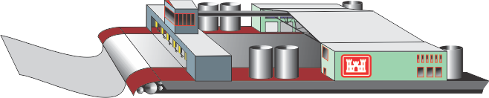
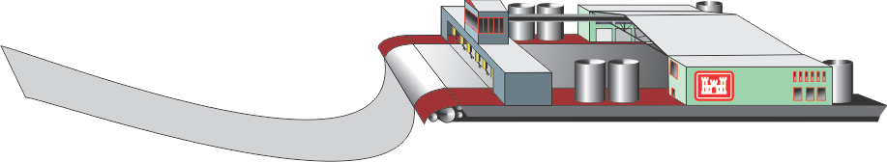
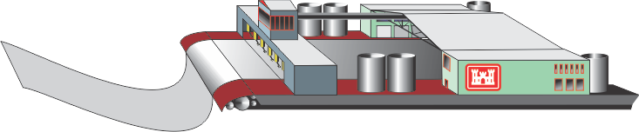
Introducing
ARMOR ONE
Cutting-edge Technology for
Automated Revetment Machine
or
Operational Navigation Enhancement
Notes:
With the continuing need to build and maintain revetment along the Mississippi River as part of the MR&T Project, a new machine to place mat is vital to the continuation of both the Corps’ navigation and flood risk management missions. With that in mind, we are exploring what a possible machine for this purpose would look like if it used all current technology and anticipated coming technologies. Here, in this slide you see a graphic representation of what a largely automated mat laying unit could look like as it lays mat.

Slide 12
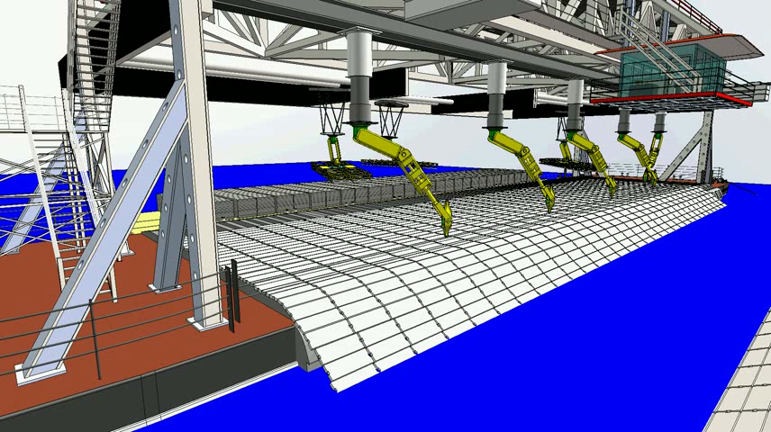

ARMOR ONE
A New Beginning
Notes:
And finally I would like to share with you an actual conceptual design which incorporates both automated mat loading and mat tying …

Slide 13
The Timeline
FY 15
FY 16
FY 17
FY 18
FY 19
FY 20
FY 21
Develop Concept
& Define Parameters
Design Phase
Construction Phase
Year
One
Construction
Phase
Year
Two
Construction
Phase
Year
Three
Phase-In
Process
Year One
Phase-In
Process
Year Two
Begin Design Drawings
Complete Design Drawings
First
Milestone
Inspection
Second
Milestone
Inspection
Final
Inspection
ARMOR ONE
Year One
Evaluation
ARMOR ONE
Year Two
Evaluation
Begin Construction
ARMOR ONE
Delivery

Slide 14


